Slide 1
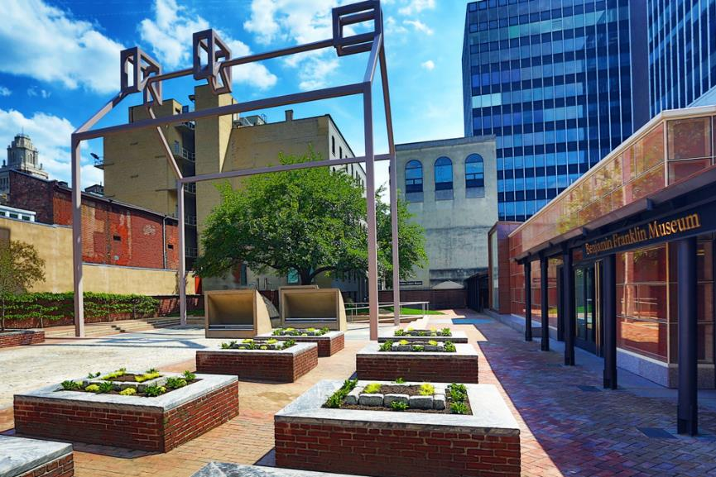
Cooperating Association Partnerships for a New Century
April 10 – 12, 2018 Philadelphia, PA

Slide 2


Cooperating Association Partnerships for a New Century
Technical vs. Adaptive

Slide 3
Cooperating Association Partnerships for a New Century
Agenda
8:30 am Complete Yesterday’s Sessions
9:00 am Morning Recap and Reflection
9:15 am Marketing Your Park Stores
9:45 am Guest Speaker: Stephanie Weaver
10:15am Break
10:30am Nonprofit Partnerships – Cooperating Associations Partnering with Other Nonprofits
11:00am Panel Q&A (Replace Networking Marketplace)*
11:15am Partnership Success Story
11:45am Participant Feedback and Closeout the Session
*Panel will remain for individual Q&A after the session as schedules permit

Slide 4
Nonprofit Activities Beyond the Standard Cooperating Association Agreement
Cooperating Association Activities:
Much More Than a Bookstore
Interpretive and Education Services Agreement
Linda Lutz-Ryan, NPS Chief of Interpretation & Education, National Capital Region
Cooperating Association Activities in Action
Daria Fink, President, and Graham Dellinger, Operations Manager
The Encampment Store at Valley Forge
Kevin Kissling, President & CEO, Eastern National

Slide 5
Nonprofit Activities Beyond the Standard Cooperating Association Agreement
Interpretive Service Agreement
Why it was created?
The value of it?

Slide 6
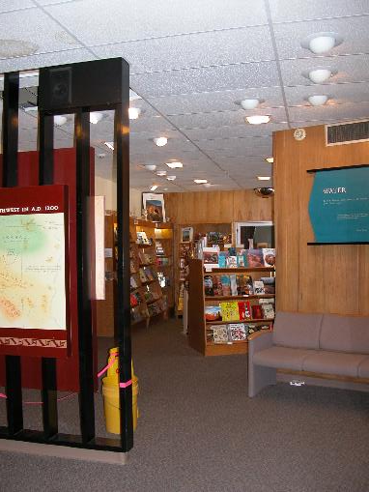
Nonprofit Activities Beyond the Standard Cooperating Association Agreement
Interpretive Service Agreement
Is it mandatory?
How is it used?
Who can it be used with?

Slide 7
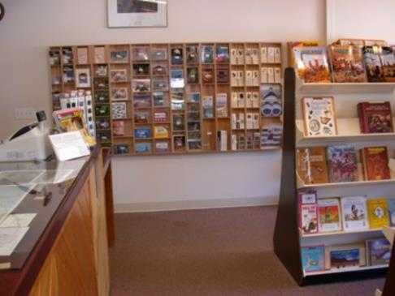
Nonprofit Activities Beyond the Standard Cooperating Association Agreement
Interpretive Service Agreement
How can it be used?
Food Service
Permits—Events and Special Use
Fees
Promotional Materials
Sales
Property Use Permit

Slide 8
Nonprofit Activities Beyond the Standard Cooperating Association Agreement
Food Under This Agreement
Interpretive Services Agreement - Food service can be authorized when it provides educational opportunity and operational efficiency. Local or ethnic foods served at events for demonstration purposes.
Food Under Other Instruments
Cooperating Association Agreement/Scope of Sales - Food under agreement. This would be food for sale that is tied to the interpretive themes of the park.
Cooperating Association Agreement/Scope of Sales (CUA) - NPS will authorize food service that is integral to the interpretive and education program and will not compete with concessions. This would be water, energy bars, sunscreen.
Operational Plan - Residential programs. Food for education programs – safety. This is food for students in day-long educational programs.

Slide 9
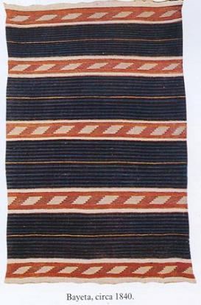
Nonprofit Activities Beyond the Standard Cooperating Association Agreement
54 U.S.C. 101702
(Formerly 16 U.S.C. 1a-2(g))
Authority to sell items produced by living demonstrations
Authority to collect fees for living history exhibits, interpretive demonstrations and tours
Use of this authority with the Interpretive Service Agreement

Slide 10
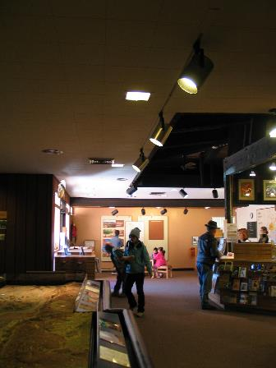
Nonprofit Activities Beyond the Standard Cooperating Association Agreement
Partners Collecting Fees
Collecting fees for programing, tours, or educational programs that either park or the partner is sponsoring.
Third Party Sale Agreement Template is needed if the partner is collecting entrance fees, park passes, or campground fees for the park.

Slide 11

Cooperating Association Activities:
We’re Much More Than a Bookstore
Activities in Action
Daria Fink
The Encampment Store, President
Graham Dellinger
The Encampment Store, Operations Manager
Kevin C. Kissling
Eastern National, President & CEO

Slide 12
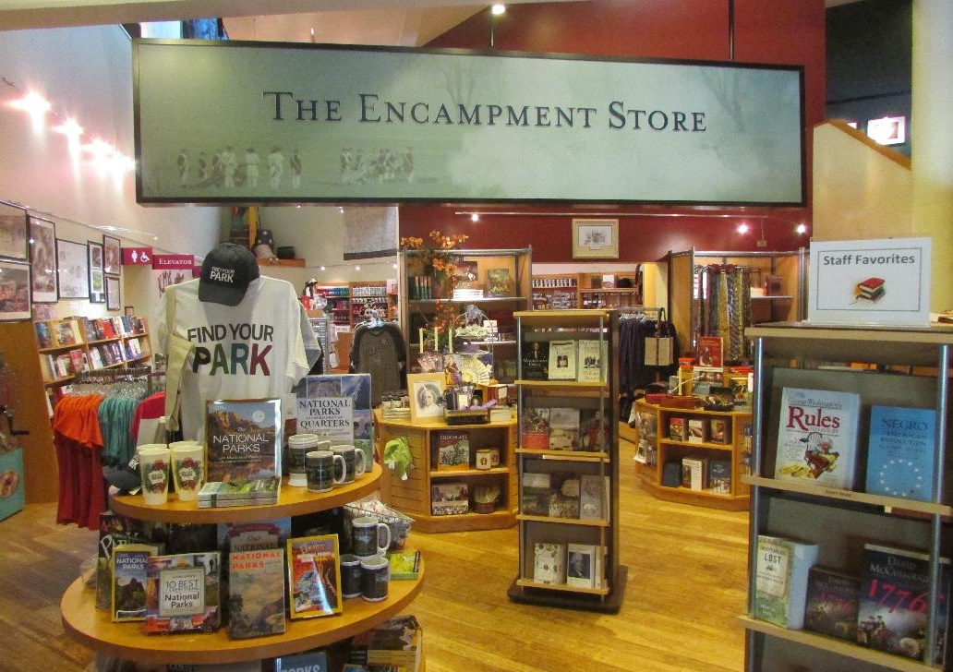
Educational
Partner at
Valley Forge
NHP

Slide 13
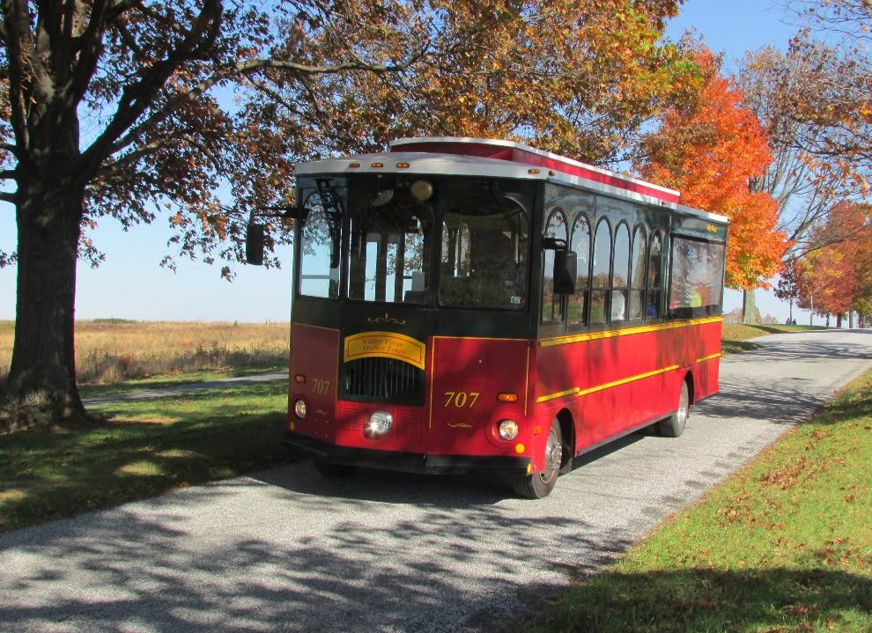
Trolley Tours
Offered to
The Public
Seasonally
94,000
Visitors
Served

Slide 14
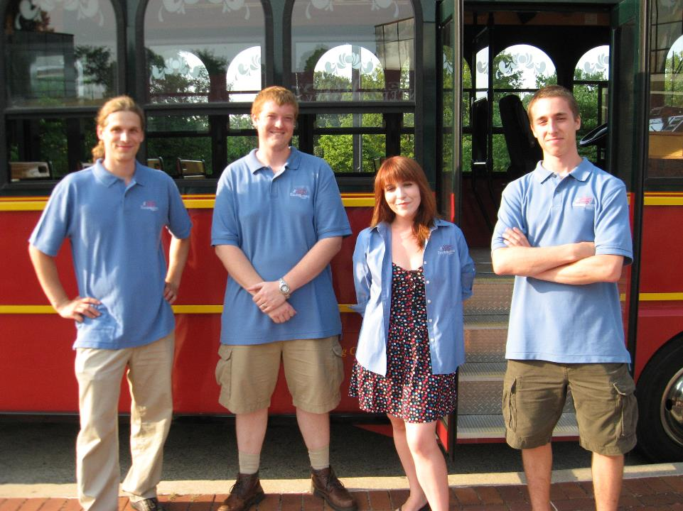
Tour Guides
Come From
Many
Backgrounds

Slide 15
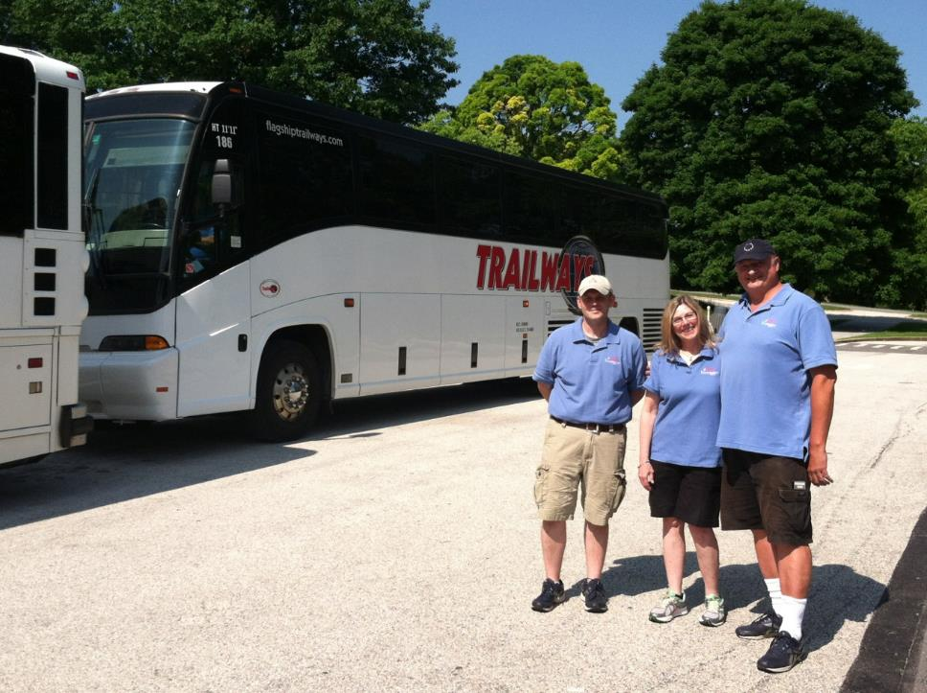
Private Tour
Guides For
Large Groups
And Families
37,400
Visitors
Served

Slide 16
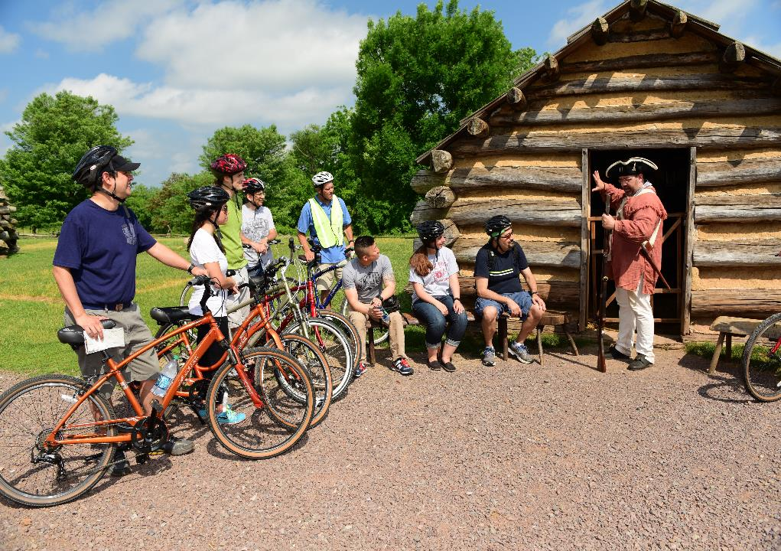
Bike Tours
& Rentals
Attract New
Audiences
2,400
Visitors
Served

Slide 17
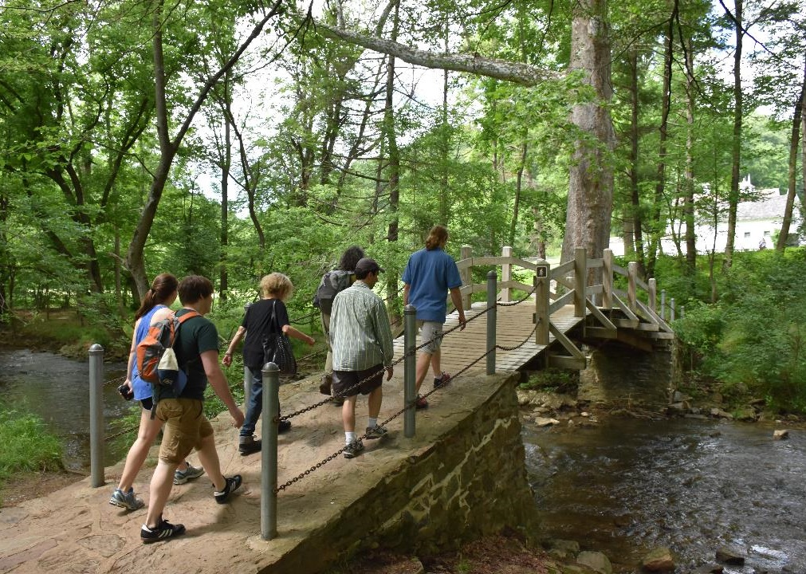
Promoting a Sustainable Business Environment
Customized
Private
Hiking
Tours

Slide 18
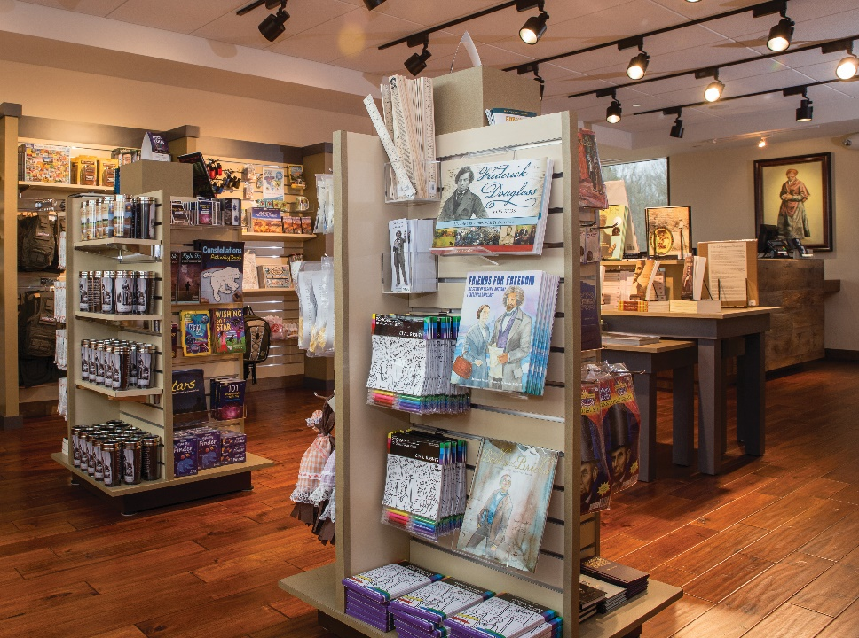

Promoting a Sustainable Business Environment
Educational
Retail Partner With:
National Park Service
USFS
USACE
State of NC
State of TN
Robert Russo Moton Museum
Parkers Crossroads

Slide 19
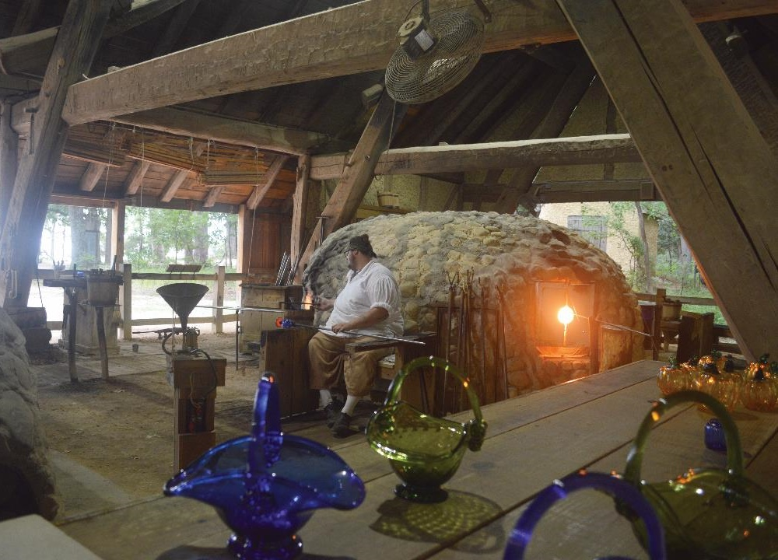
Promoting a Sustainable Business Environment
Jamestown
Glasshouse
Interpretive
Services
223,000
Visitors
Served

Slide 20
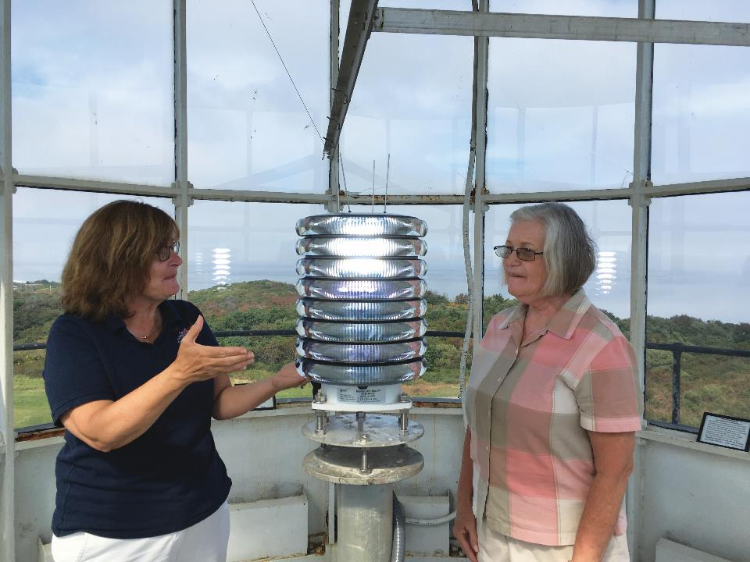
Promoting a Sustainable Business Environment
Highland
Light
Tours &
Museum
21,000
Visitors
Served

Slide 21
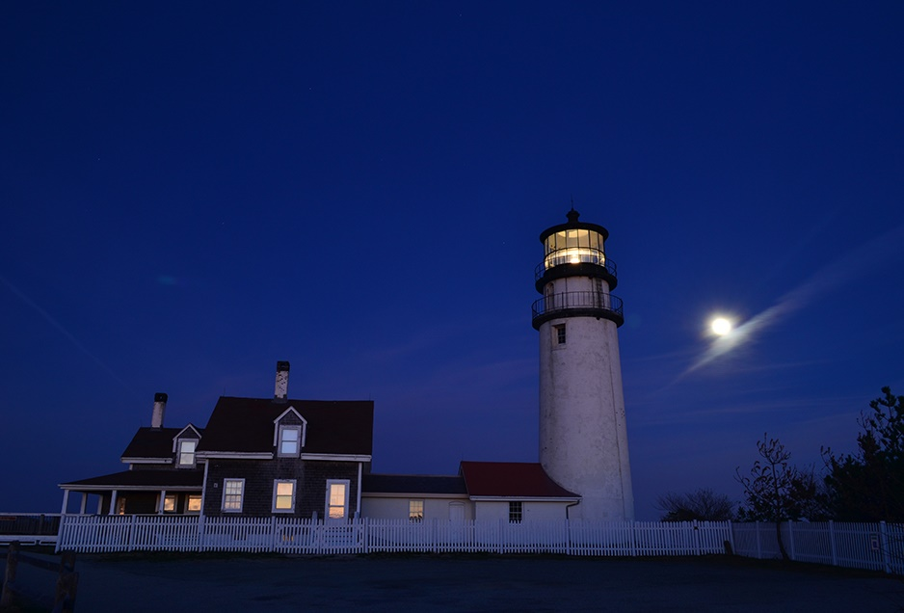
Promoting a Sustainable Business Environment
Highland
Light
Evening
Tours

Slide 22
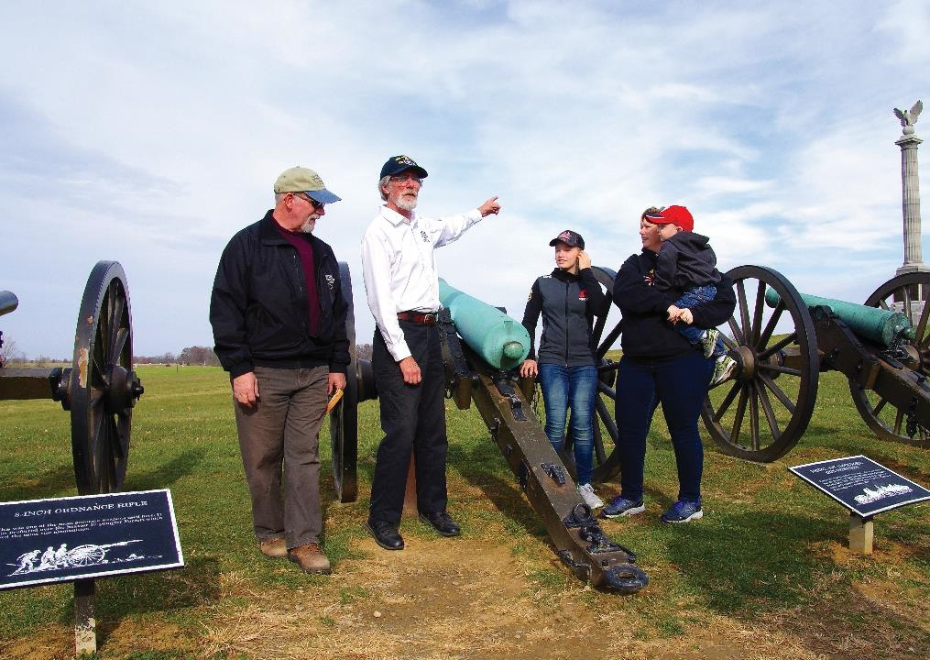
Promoting a Sustainable Business Environment
Antietam NB
Battlefield
Guide
Services
8,300
Visitors
Served

Slide 23
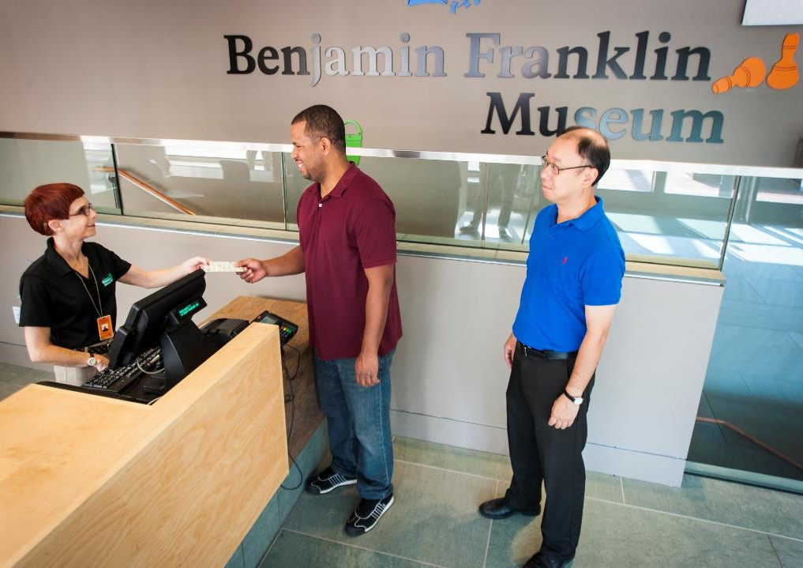
Promoting a Sustainable Business Environment
Interpretive
Fee
Collection
Services
99,200
Visitors
Served

Slide 24
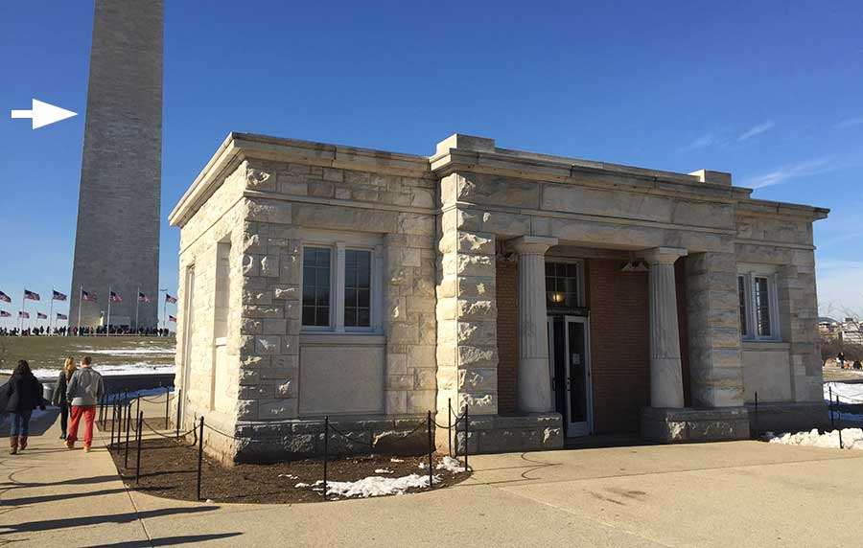
Promoting a Sustainable Business Environment
Washington
Monument
Ticket
Distribution
400,000
Visitors
Served

Slide 25
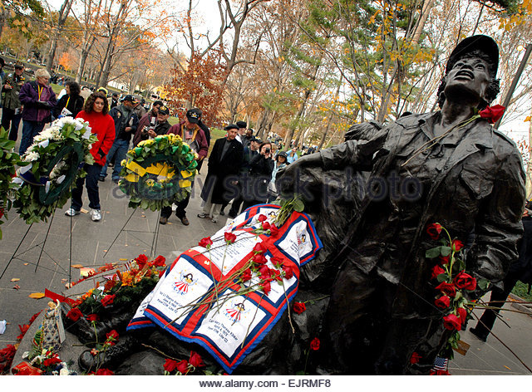
Promoting a Sustainable Business Environment
Interpretive
Programs
Vietnam
Women's
Memorial

Slide 26
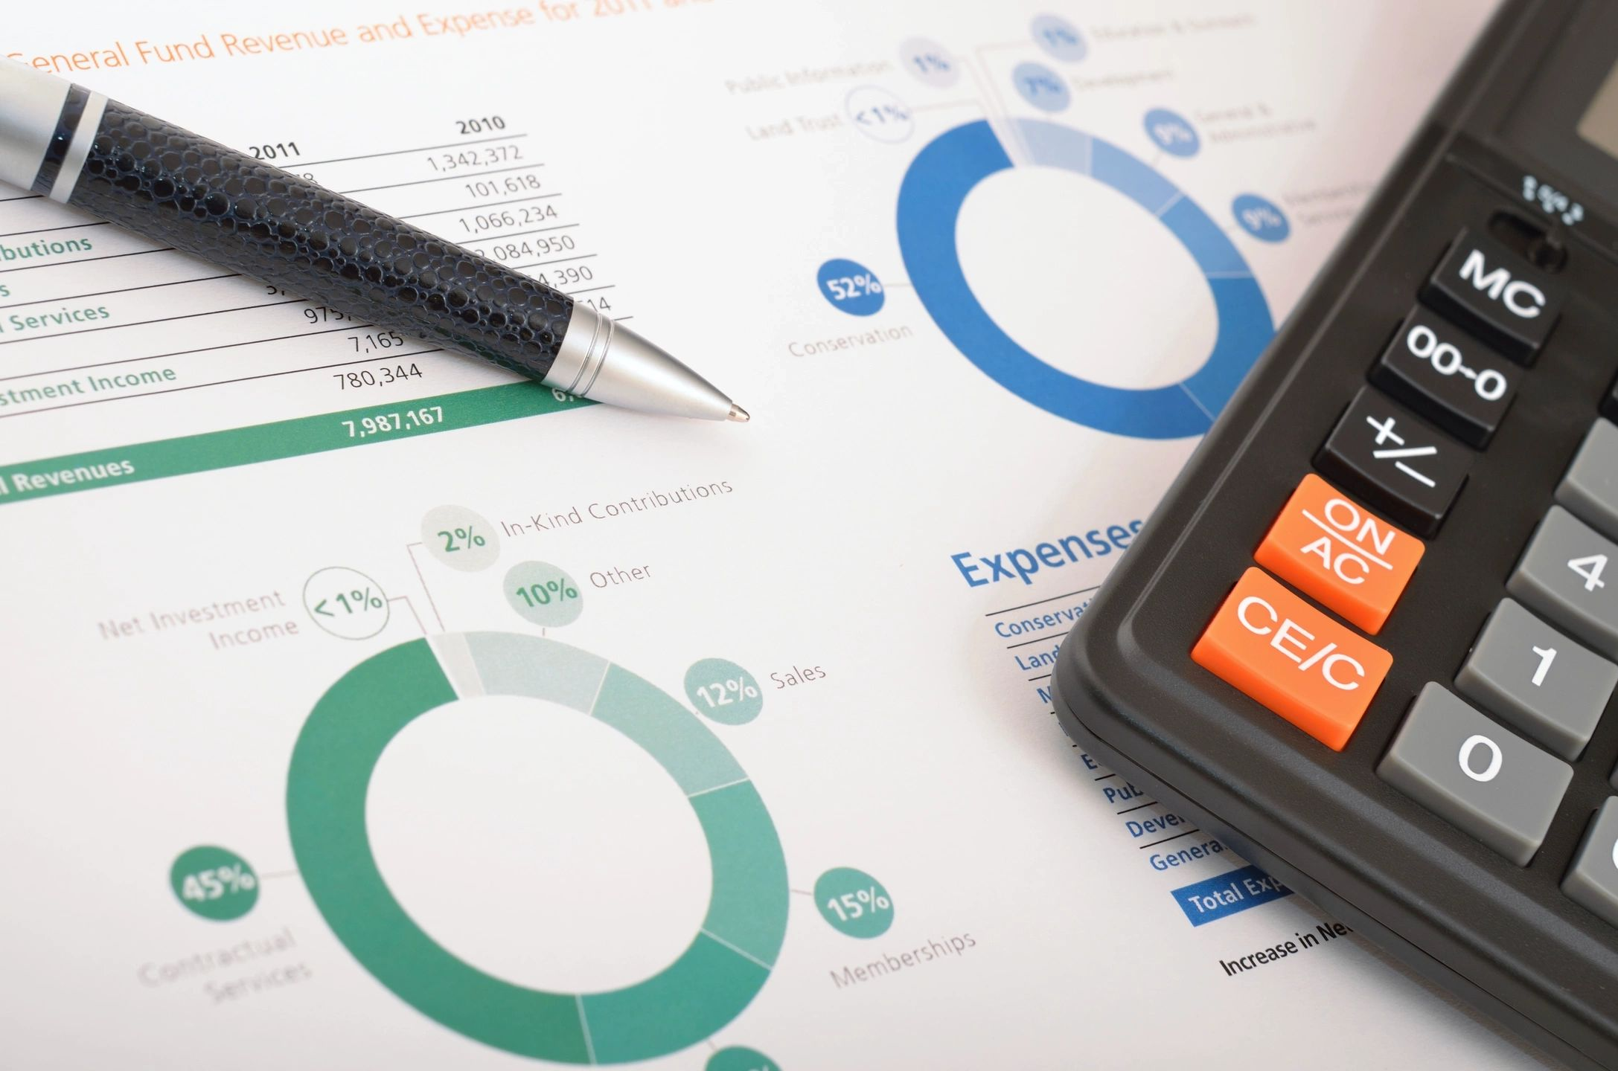
Promoting a Sustainable Business Environment
Fiduciary
Services &
Cooperative
Agreements

Slide 27

Promoting a Sustainable Business Environment
Philanthropic
Services

Slide 28
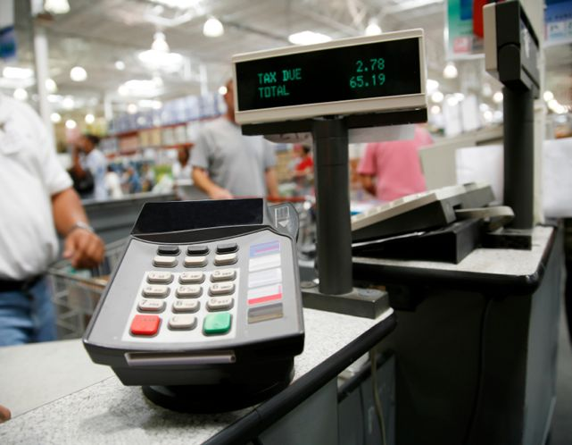
Promoting a Sustainable Business Environment
Checkout
Counter
Donation
Program

Slide 29
Morning Recap and Reflection
Meredith McClatchy
Eastern National - Director of Human Resources

Slide 30
Marketing Your Park Stores & Products
Emily Geesaman
Eastern National Marketing Manager

Slide 31
Marketing Your Park Stores & Products
Discussion Topics
Marketing Basics
Eastern National Mar-Comm Team Structure
Success Stories
Sharing Best Practices
Q&A

Slide 32

Marketing Your Park Stores & Products
Marketing Basics: Set a Strategy
Strategy = Creating a Road Map
= Your Plan to “Get You There”
= Guidelines for Your Marketing Activities

Slide 33


Marketing Your Park Stores & Products
Marketing Basics: Match Message to Audience
Interest
Channel
Tone

Slide 34

Marketing Your Park Stores & Products
Marketing Basics: Repurpose Content
Original Content (content you create)
Shared Content (news from other sources)

Slide 35
Marketing Your Park Stores & Products
Marketing Basics: Repurpose Content
Content
Social Media Post
Newsletter
Article
Blog Post
Website
Annual Report
eblast

Slide 36

Marketing Your Park Stores & Products
Marketing Basics: Leverage the “Local Network”
Tourism Groups
Local Businesses
Media Outlets
Other Parks or Partners
Influencers

Slide 37
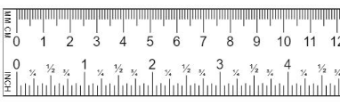
Marketing Your Park Stores & Products
Marketing Basics: Measure ROI
Click-throughs
Engagement (Likes, Follows, Shares, etc.)
Impressions
Open Rate
Number of Visitors
Sales
Coupon redemption
Notes:
Important to establish how you’ll measure your marketing efforts before you begin to determine whether or not they’re successful and worth repeating or nixing.

Slide 38





Marketing Your Park Stores & Products
EN Mar-Comm Team Structure: Who We Are
Jason Scarpello
Creative Director
Emily Geesaman
Marketing Manager
David Eberle
Marketing Specialist
Karen
Wernick
Communications Specialist
Curt Clinefelter
Graphic Designer
Notes:
Responsibilities are scattered across the team
Marketing Request Form to facilitate field requests
Marketing Support Model “menu”

Slide 39

Marketing Your Park Stores & Products
EN Team Structure: What We Can Do For You

Slide 40
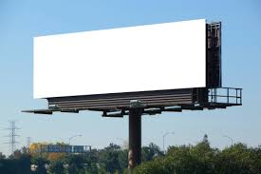
Marketing Your Park Stores & Products
EN Team Structure: What We Can’t Do For You
VISIT THIS PARK!

Slide 41



Marketing Your Park Stores & Products
EN Team Structure: Field Marketing Support Menu

Slide 42




Marketing Your Park Stores & Products
EN Structure: Field Marketing Support Menu
Notes:
Is it possible to share a list of resources, so I can link to the Field Model Training presentation to share with others?

Slide 43


Marketing Your Park Stores & Products
EN Team Structure: Field Marketing Support Menu

Slide 44

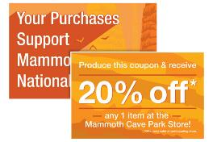

Marketing Your Park Stores & Products
Success Stories: Mammoth Cave
Integrated messaging across signage promoted mission; differentiated from concessionaire
Discount coupon offered incentive to shop at “park store”
ROI = closing the gap in lost sales from concessionaire, exact results still pending
Discount coupon
Stand-up banner signage
Advertisement for TV screen at VC

Slide 45
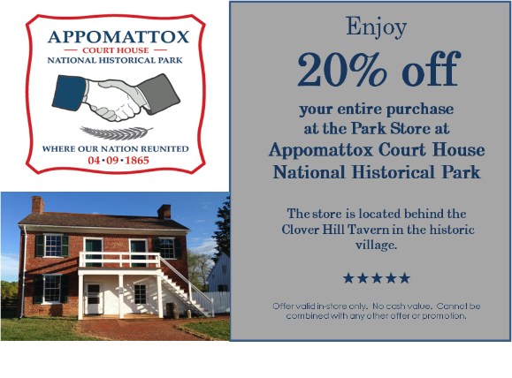
Marketing Your Park Stores & Products
Success Stories: Appomattox 152nd Anniversary
Discount coupons included in goody bags at anniversary event to drive store traffic and sales
Cost of coupons = $205 for 1,000 coupons
Coupons redeemed = 223
Sales redeemed = $1,637
ROI = $1,432; nearly 8 times the cost of printing. Membership to local tourism group renewed.

Slide 46
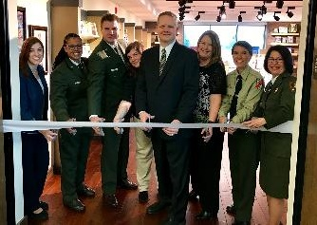
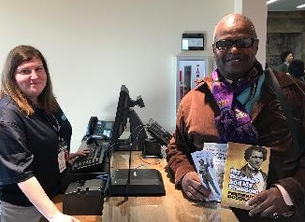
Marketing Your Park Stores & Products
Success Stories: Harriet Tubman Underground Railroad New Store Opening
Developed media kit with fact sheet, store photos
Worked with tourism groups and NPS for inclusion in media kit materials and outreach; ensuring park store and products are part of the story
Hosted author book signing event
Distributed discount coupons at opening event and at local Visitor Center
Shared NPS posts and photos of ribbon-cutting and first customer on social media

Slide 47
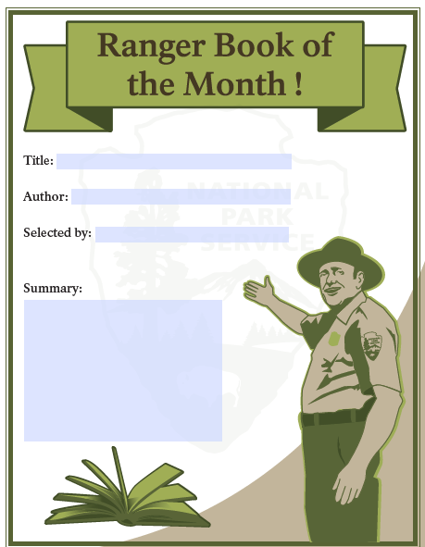
Marketing Your Park Stores & Products
Success Stories: Lincoln Birthplace
EN worked with NPS staff to create customizable (editable) signage template to feature “book of the month” chosen by park rangers.
ROI: increase in sales month-to-month due, in part by, this sign. Other parks looking to leverage this “stamp of approval.”
Notes:
This is an example of a signage template we’re working on developing for our stores, so they can customize it based on their needs. By positioning these products as a “pre-approved pick” from a ranger gives a certain stamp of approval, or perceived value by the visitor.

Slide 48

Marketing Your Park Stores & Products
Success Stories: Cumberland Gap
EN staff consulted with NPS park staff on social media strategy to connect park store products and mission (purchases support parks) to park experience.

Slide 49
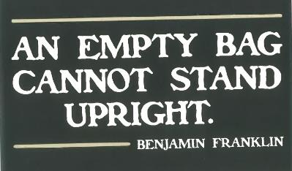
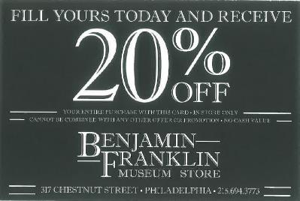
Marketing Your Park Stores & Products
Success Stories: Ben Franklin Museum Store
Independence Hall and Ben Franklin Museum stores offer this discount coupon to drive intra-park visitation between the two stores within Independence National Historical Park.

Slide 50
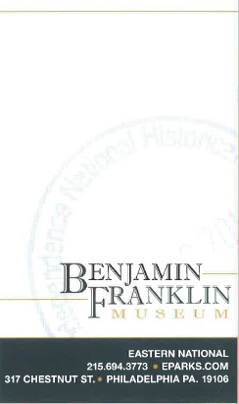
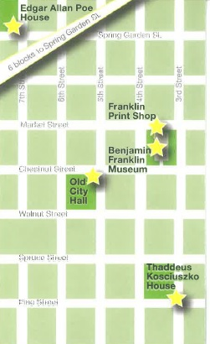
Marketing Your Park Stores & Products
Success Stories: Ben Franklin Museum Store
Passport cancellation card offers visitors a place to stamp the park cancellation (left), with a map guiding / encouraging them to visit the other sites and stores within the park on the back (right).

Slide 51
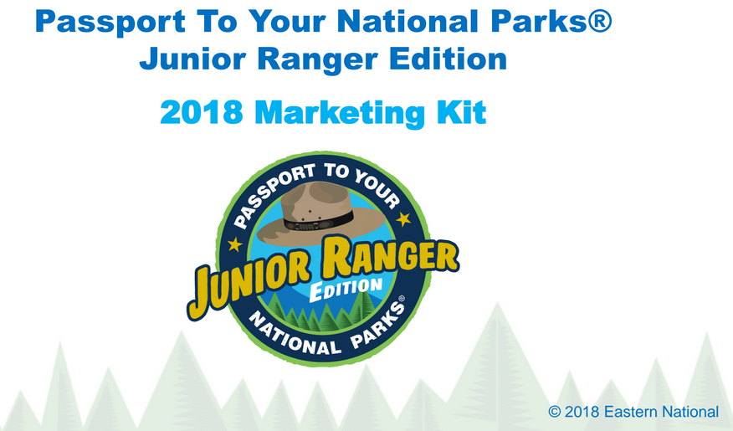
Marketing Your Park Stores & Products
Success Stories: Grassroots Marketing with Kits
PDF serves as instructions
Graphics, logos
Photos
Social media assets (suggested copy, hashtags, handles)
Marketing collateral (signage)
FAQs
Tip Sheet

Slide 52
Marketing Your Park Stores & Products
Sharing Best Practices
Thoughts or questions on these examples?
Similar success stories?
Current challenges you’re facing at your park(s)?

Slide 53
Visitor Experiences
Stephanie Weaver
Experienceology

Slide 55

Break Time

Slide 56
Nonprofit Partnerships
Cooperating Associations Partnering with Philanthropic Partners
Megan Cartwright
Eastern National - Chief Operating Officer
Notes:
Based on the need for mutually beneficial agreements among cooperating associations and other nonprofit organizations, Eastern National will share the Partnership Agreement model that is currently in development and will be included in the Annual Operating Plan.

Slide 57
Nonprofit Partnerships
What?
Communication tool between EN and other Park Partners (i.e. Friends Groups)
Establishes roles and commitments
Why?
Provide consistency in the way EN partners with Friends Groups
At the request of NPS, more support for Friends Groups is required
How?
Formal agreement: Memorandum of Understanding (MOU)
Superintendent should indicate in the Annual Operating Plan which partner(s) EN should work with.
Allows for a mutually beneficial partnership
Supports a shared vision of success
MOU is between EN and other Philanthropic Partner at the request of NPS. Only EN and Park Partner sign the MOU.
Notes:
Varying agreements in every park we operate
No consistency
Not always in EN’s best interest
Conducted research with key stakeholders:
All EN managers completed an assessment of current informal agreements – almost as many as the number of parks we work with; no formal documentation (many handshake deals)
Conducted needs assessment with external stakeholders including NPS partners and philanthropic partners
Identified areas of risk (ending current practices, saying no to requests)
Developed a draft agreement
Shared with 30 key stakeholders and asked for feedback on the draft agreement
Made edits and created a fillable pdf version for easy completion.

Slide 58
Nonprofit Partnerships
Purpose of a Partnership Agreement
Formalize current relationships with other Philanthropic Partners
Offer mutually beneficial options for Cooperating Association and Philanthropic Partner
Customizable agreement based on variety of park partnership agreements

Slide 59
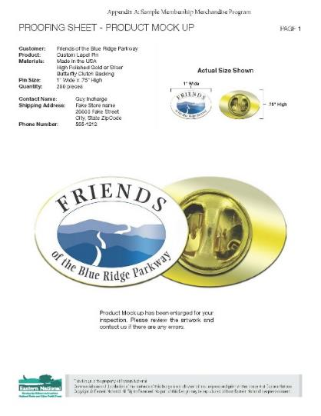
Nonprofit Partnerships
Elements of the Partnership Agreement
Option 1: Sale of items developed by Philanthropic Partner
Option 2: Development of EN items with Partner’s Intellectual Property
Option 3: Membership Merchandise Program
Option 4: Membership Discount at EN location
Notes:
Difference between Option 1 and 2:
Product development; Option 1 partner is set up like a vendor; Option 2 EN controls development
Inventory ownership; Option 1 partners owns inventory, we buy at our discretion. Option 2 EN owns inventory so we price accordingly
Pricing and purchasing strategies
Option 3: we co-create and proceeds go to the Partner
EN selects vendor; negotiates pricing, leverages volume
Use of template creates efficiency
Actively promotes mission and membership of Philanthropic Partner
Ensure quality, interpretive value of the products
Create a streamlined process to maximize ROI – mission and money
Option 4: if an agreement is in place, Partner group can use EN 15% discount as added value for their membership; ONLY at the Park where you are a member.

Slide 60
Partnerships – Cooperating Associations and Other Nonprofit Organizations
Option 1:
Sale of items developed by Philanthropic Partner
  Product development
  Inventory ownership
  Pricing and purchasing strategies

Slide 61
Nonprofit Partnerships
Option 2:
Development of EN items with Partner’s Intellectual Property
  Product development
  Inventory ownership
  Pricing and purchasing strategies

Slide 62
Nonprofit Partnerships
Option 3:
Membership Merchandise Program
  Co-create product development
  Actively promotes mission and membership of Philanthropic Partner
  Ensure quality, interpretive value of the products
  Create a streamlined process to maximize ROI – mission and money

Slide 63
Nonprofit Partnerships
Option 4:
Partner Discount at EN locations
  15% discount for participating partnerships – members and employees
  Additional value to encourage membership

Slide 64
Nonprofit Partnerships
Next Steps
  Discuss MOU with Park Superintendents during Annual Operating Plan meetings to gauge interest
  Meet with designated Philanthropic Partners to share MOU and discuss options
  Select preferred vendor to manage Option 3: Membership Merchandise Program
  Signed copies of MOU will be attached to Annual Operating Plans
  Eastern National’s 2018 Goal
Notes:
2018 Goal: Each RM is asked to pursue formalizing MOUs with 2 agreements
Ask Aimee to speak about Friends of Stones River experience

Slide 65
Panel Q&A

Slide 66
Partnership Success Story
Salem Maritime National Historic Site
Jonathan Parker
NPS, Valley Forge NHP, Chief of Interpretation
Susan Russo
NPS, Salem Maritime NHS, Chief, Division of Visitor Experience & Community Engagement
Kevin C. Kissling
Eastern National, President & CEO

Slide 67
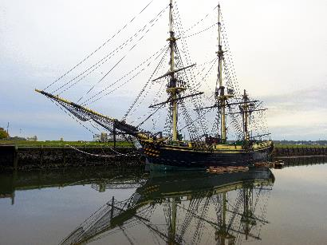
Your Session Title Goes Here, on One Line
Site Orientation
Overview Salem National Historic Site & Salem, MA

Slide 68
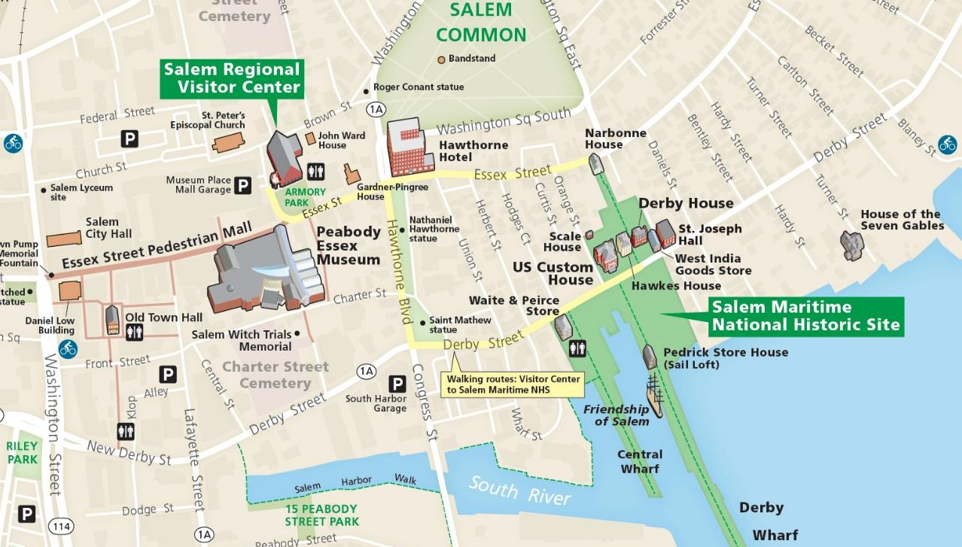
Your Session Title Goes Here, on One Line
Your Slide’s Header Goes Here,
Up to Two Lines
Bullet 1 (or image)
Bullet 2
Bullet 3
Duplicate this slide as necessary!

Slide 69
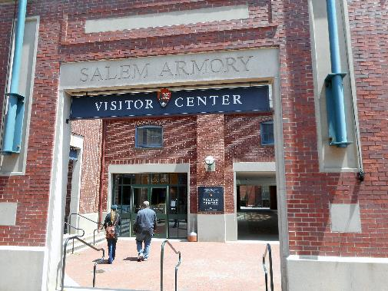
Your Session Title Goes Here, on One Line
Site Orientation
Overview Salem National Historic Site & Salem, MA
Visitor use and wayfinding in the park
The orientation center

Slide 70
Your Session Title Goes Here, on One Line
Origins Of A Challenge
The two poles of staffing requirements
The Budget Control Act of 2011 (sequestration)
A frustrating reality

Slide 71
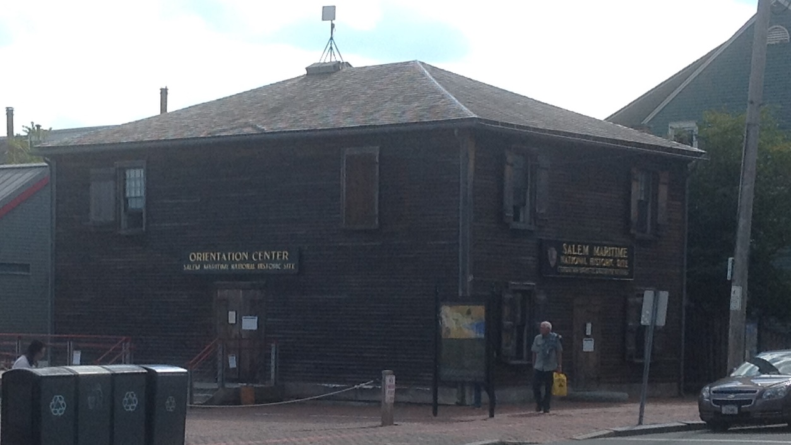

Slide 72

Your Session Title Goes Here, on One Line
Genesis Of A New Idea
New leaders, new ideas
Thinking outside the park
  Travelling to Mystic Seaport
  Breaking bread together
The Idea
Calculated risk taking, investment, belief

Slide 73
Your Session Title Goes Here, on One Line
Ingredients Of A Successful Partnership
Trust, openness, and free exchange of ideas
Getting outside the park and spending time together
Breaking the mold, iterative experimentation, and flexibility
Mutual investment, symbiosis

Slide 74
Your Session Title Goes Here, on One Line
Demolition, Design, And Construction
Shared resources
Planning and patience
Co-creating an experience
Projection completion

Slide 75
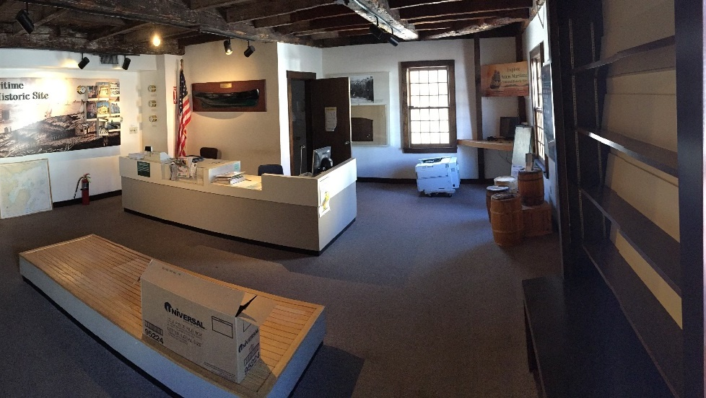

Slide 76
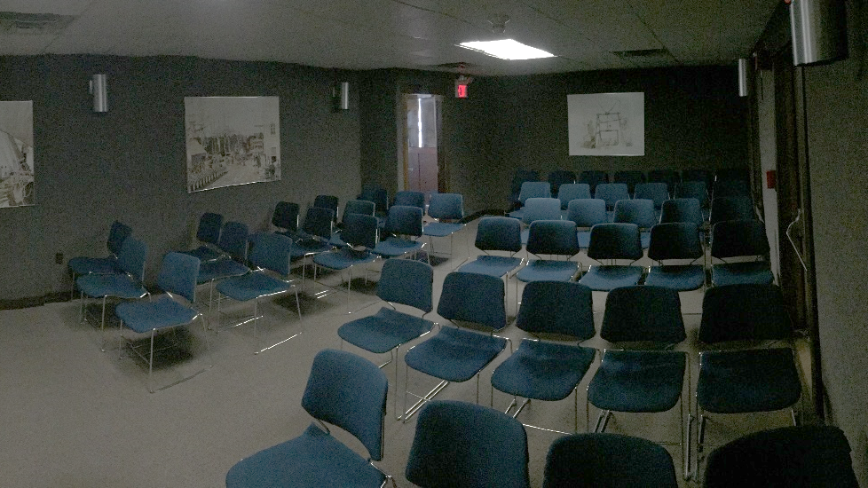

Slide 77
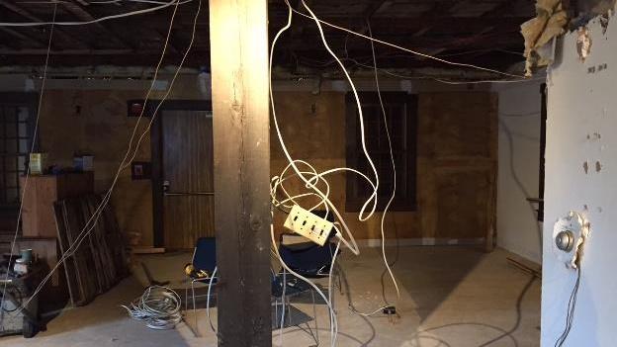

Slide 78
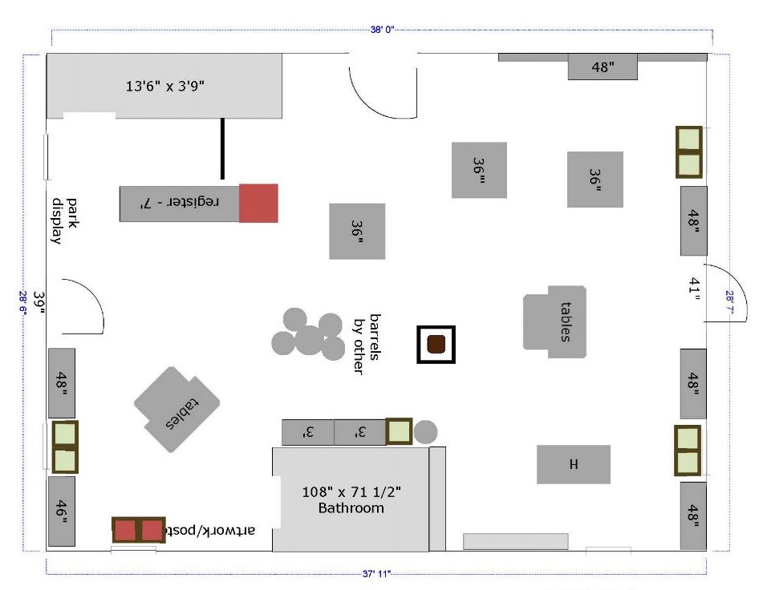

Slide 79
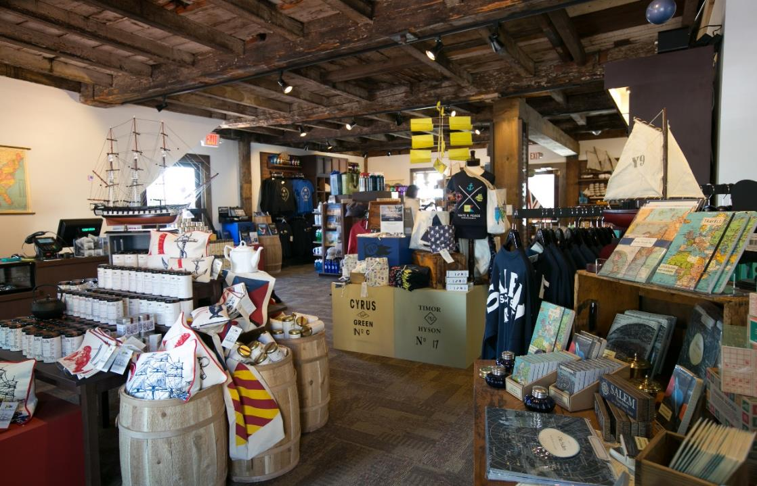

Slide 80
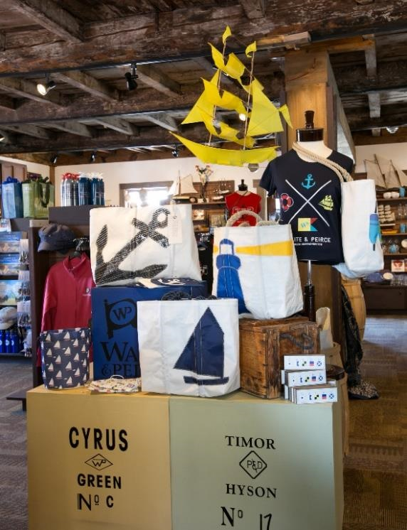
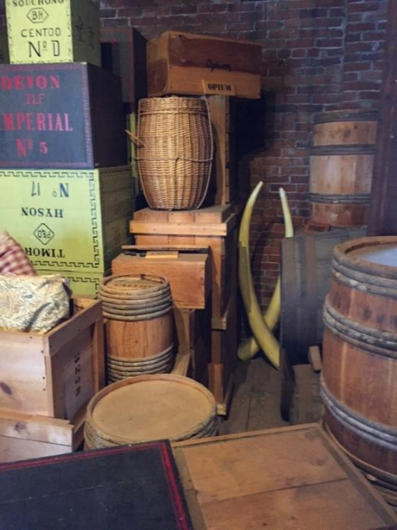

Slide 81
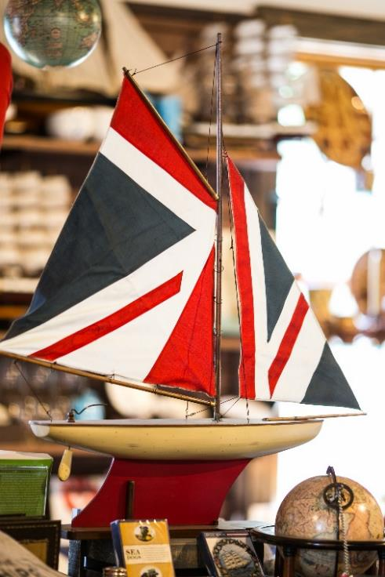
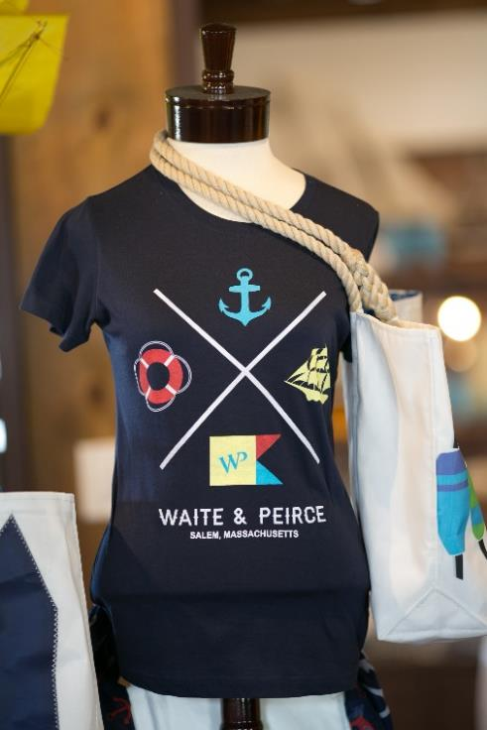

Slide 82
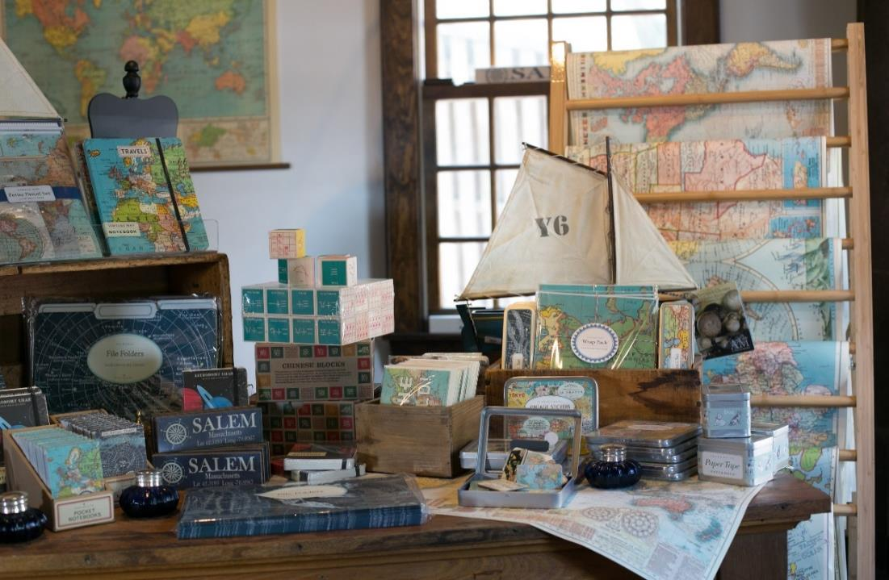

Slide 83
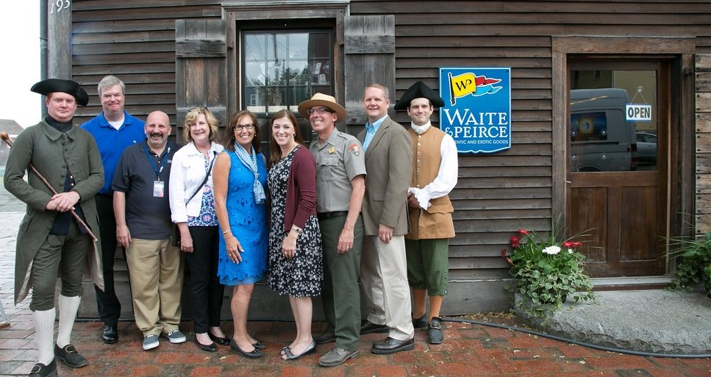

Slide 84
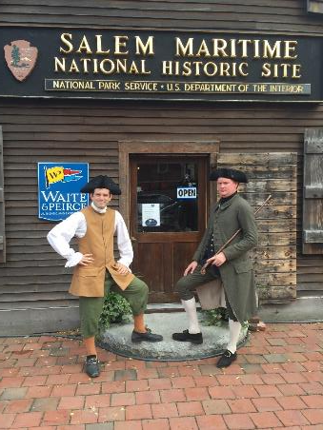
Your Session Title Goes Here, on One Line
Financial Results
VC
FY 2015 $160,000
FY 2014 $148,000

Slide 85
Your Session Title Goes Here, on One Line
Financial Results
W&P VC Combined
FY 2016 $ 99,000 $175,000 $274,000
FY 2015 $ 0 $160,000 $160,000
FY 2014 $ 0 $148,000 $148,000

Slide 86
Your Session Title Goes Here, on One Line
Financial Results
W&P VC Combined
FY 2017 $141,000 $208,000 $349,000
FY 2016 $ 99,000 $175,000 $274,000
FY 2015 $ 0 $160,000 $160,000
FY 2014 $ 0 $148,000 $148,000

Slide 87

Your Session Title Goes Here, on One Line
Where Are We Today
Vision of a community shop
Supporting local events at the park & the community
Working with local groups: dog walkers, garden clubs
Local repeat customer; not a souvenir store
Mind Shift: from “bookstore” to “local boutique”

Slide 88
Your Session Title Goes Here, on One Line
How Has The W&P Store Evolved
Challenge: adapting from primary reason store opened
Established to support the Friendship of Salem
Customer needs: shift in product assortment
Opportunity to sell high-end products
Junior ranger program

Slide 89

Your Session Title Goes Here, on One Line
Where are we going?
Collaborate to expand interpretive programs
Building similar model at Saugus Iron Works NHS Broadhearth Store
Return of Friendship; connecting W&P product to ship
Exploring new ways to promote site and W&P Shop
Evaluating shift in foot traffic and expand reach through partnerships

Slide 90
Your Session Title Goes Here, on One Line
Tying It All Back To This Week’s Training
Purpose of a cooperating association
Keeping partnerships on track
Need for cooperating association to have resources for new opportunities
NPS resources & foregoing aid to park from W&P sales
Interpretive products and store design
Sales item approval process
Interpretive and education services agreement
We’re much more than a bookstore
This week’s lesson: put what you learn to work!

Slide 91
End of Day
Wrap Up

Slide 92
Cooperating Association Partnerships for a New Century
April 10 – 12, 2018 Philadelphia, PA

